Slide 1
MCP101 Project Title: Footstep Electric Generator

Slide 2
Representatives: Group : 18-D
NAME ENTRY NO.
1.Shriyanshi Garodia 2023CH10212
2.
3.
4.
5.
6.
7.
8.
9.
10.
11.
12.
13.
PROJECT’S PHOTO

Slide 3
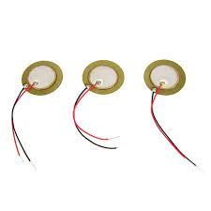
HARDWARE COMPONENTS REQUIRED:
20mm Piezo Electric Generator
A 20mm piezoelectric generator typically refers to a device that utilizes the piezoelectric effect to convert mechanical energy into electrical energy. Piezoelectric materials generate a voltage when subjected to mechanical stress or strain, such as bending or vibration.
Here's a basic outline of how such a generator might work:
Piezoelectric Material: The heart of the generator is a piezoelectric material. Common materials used include quartz, Rochelle salt, and certain ceramics. These materials have the property of generating an electric charge in response to applied mechanical stress.
Mechanical Stress: The piezoelectric material is mechanically stressed or deformed. This can be done through various means such as bending, squeezing, or vibrating the material.
Electric Charge Generation: When mechanical stress is applied to the piezoelectric material, it generates an electric charge across its surface.
Electrical Output: This electric charge is collected by electrodes placed on the surface of the piezoelectric material. The electrodes are connected to an electrical circuit where the generated electrical energy can be stored or used to power electronic devices.
Energy Storage or Usage: The generated electrical energy can be stored in batteries or capacitors for later use, or it can directly power small electronic devices depending on the application.

Slide 4
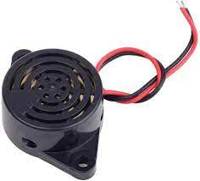
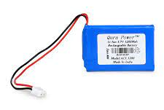
3-24V Buzzer Beep Alarm
This mini electronic beeper support DC 3-24V power supply and produce continuous high-decibel alarm sound up to 85dB. It has 30mm diameter and 15mm thickness with 2-wire pigtails which are easy to connect. These are widely used in the car modification, DIY electronics reminder projects or other area needs sound alarm.
3.7V DC rechargeable battery
A rechargeable battery, storage battery, or secondary cell (formally a type of energy accumalator), is a type of electrical battery which can be charged, discharged into a load, and recharged many times, as opposed to a disposable or primary battery, which is supplied fully charged and discarded after use. It is composed of one or more electrochemical cells . The term "accumulator" is used as it accumalates and stores energy through a reversible electrochemical reaction. Rechargeable batteries are produced in many different shapes and sizes, ranging from button cells to megawatt systems connected to stabilize an electrical distribution network.

Slide 5
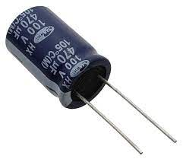
100V capacitor (470micF)
A capacitor is a device that stores electrical energy by accumulating electric charges on two closely spaced surfaces that are insulated from each other. A 100V capacitor refers to a capacitor rated for use with a maximum voltage of 100 volts. Capacitors can be used in conjunction with voltage regulators to stabilize the output voltage of the generator. In situations where there are fluctuations in the load or in the generator's operating conditions, capacitors can help smooth out voltage spikes and dips, ensuring a more consistent and reliable power supply. They can also be used as part of filtering circuits to remove unwanted noise, harmonics, and ripple from the generator output. By smoothing out the voltage waveform and reducing electromagnetic interference (EMI), capacitors help improve the quality of the power supply and enhance the performance of connected equipment.

Slide 6
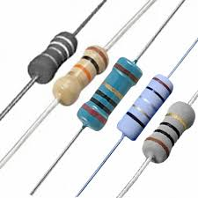
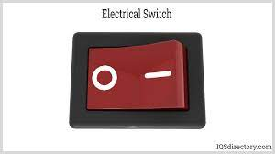
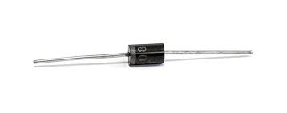
Resistors
Load resistors are often used in generator systems for testing, calibration, or simulation purposes. They are connected to the generator output to simulate a load and ensure that the generator operates within its rated capacity. Resistors can be used as part of voltage regulation circuits to control the output voltage of the generator. In voltage regulation schemes such as shunt regulators or series regulators, resistors are used to adjust the excitation current of the generator's field winding, thereby regulating the output voltage.
Switch
One of the most basic uses of a switch in a generator system is to control the starting and stopping of the generator. In backup power systems or installations where multiple power sources are available (such as mains power and a generator), a transfer switch is used to seamlessly switch between the power sources. When the mains power fails, the transfer switch automatically connects the generator to the load, ensuring uninterrupted power supply.
Diode
Diodes are commonly used in generator systems to convert the AC output of the generator into DC voltage. This process is called rectification. In a typical setup, one or more diodes are configured in a rectifier bridge circuit, such as a full-wave or half-wave rectifier, to ensure that the generated AC voltage is converted into a unidirectional DC voltage suitable for charging batteries or powering DC loads.By connecting zener diodes in parallel with the load or in series with the generator output, the voltage across the load can be maintained within a specific range, even when the generator's output voltage fluctuates due to changes in load or operating conditions.

Slide 7
Working of the project
1)Explanation of the Piezoelectric Effect:
The piezoelectric effect is a phenomenon in certain materials where they produce an electric charge in response to mechanical stress and deform when subjected to an electric field.The footstep electricity generator utilizes the piezoelectric effect to convert mechanical energy from foot traffic into electrical energy. Piezoelectric sensors are strategically placed in the generator's design, such as within walkways or flooring. When a person steps on these sensors, the mechanical stress from their weight causes the piezoelectric material to deform, generating an electric charge. This charge is then captured and stored or immediately used as electricity, forming the basis for the generator's operation.

Slide 8
Design and Implementation of the Footstep Electricity Generator:
Circuit diagram to be pasted over here
The design process of the footstep generator involves several key steps, including the selection of piezoelectric materials, sensor placement, and integration into the infrastructure. Here's a breakdown of each aspect:
Selection of Piezoelectric Materials
The design process begins with the careful selection of suitable piezoelectric materials. Common piezoelectric materials include lead zirconate titanate (PZT), polyvinylidene fluoride (PVDF), and certain ceramics.
Factors considered during material selection include piezoelectric coefficient (which determines the material's efficiency in converting mechanical stress to electrical charge), mechanical properties, durability, and cost.
The chosen material should exhibit high sensitivity to mechanical stress and be capable of withstanding the anticipated load and environmental conditions.

Slide 9
Sensor Placement:
Once the piezoelectric material is selected, the next step is to determine the optimal placement of sensors within the infrastructure, such as walkways or floors.
Sensors are strategically positioned in areas with high foot traffic to maximize energy harvesting efficiency. This may involve conducting site surveys and analyzing pedestrian flow patterns to identify optimal locations.
Sensors should be placed in such a way that they can effectively capture mechanical stress from foot impacts while ensuring durability and longevity.
Integration into the Infrastructure:
The footstep generator is integrated into the infrastructure, typically by embedding or surface-mounting the sensors within walkways, floors, or other high-traffic areas.
Depending on the specific application and infrastructure requirements, various installation methods may be employed, such as embedding sensors in concrete or securing them to existing flooring surfaces.
Careful consideration is given to factors such as structural integrity, aesthetics, accessibility, and maintenance requirements during the integration process.
Wiring and connection points are established to facilitate the transfer of electrical energy generated by the piezoelectric sensors to the charging system or storage mechanism.
Overall, the design process of the footstep generator involves meticulous planning and consideration of materials, sensor placement, and integration techniques to ensure optimal performance, durability, and seamless integration into the target infrastructure.

Slide 10
Practical feasibility of this project
Renewable Energy Generation: The project harnesses foot traffic to generate electricity through piezoelectric technology, providing a renewable and sustainable energy source.
Cost Savings: By generating electricity from foot traffic, the project offers a cost-effective alternative to traditional energy sources. It reduces utility bills and operational expenses for facilities such as shopping malls, stadiums, airports, and public transportation hubs.
Urban Sustainability: In urban environments with high pedestrian traffic, the footstep generator can serve as a valuable energy harvesting solution. It utilizes existing infrastructure (footpaths, walkways) to generate clean energy without occupying additional space.
Reduction of Carbon Footprint: The use of renewable energy sources like the footstep generator contributes to the reduction of greenhouse gas emissions and mitigates climate change.

